Slide 1
SQL
Database

Slide 2
SQL is a database computer language designed for the retrieval and management of data in a relational database. SQL stands for Structured Query Language.
SQL is Structured Query Language, which is a computer language for storing, manipulating and retrieving data stored in a relational database.
SQL is the standard language for Relational Database System. All the Relational Database Management Systems (RDMS) like MySQL, MS Access, Oracle, Sybase, Informix, Postgres and SQL Server use SQL as their standard database language.
Also, they are using different dialects, such as −
MS SQL Server using T-SQL,
Oracle using PL/SQL,
MS Access version of SQL is called JET SQL (native format) etc.

Slide 3
What can SQL do?
SQL can execute queries against a database
SQL can retrieve data from a database
SQL can insert records in a database
SQL can update records in a database
SQL can delete records from a database
SQL can create new databases
SQL can create new tables in a database
SQL can create stored procedures in a database
SQL can create views in a database
SQL can set permissions on tables, procedures, and views

Slide 4
To build a web site that shows data from a database, you will need:
An RDBMS database program (i.e. MS Access, SQL Server, MySQL)
To use a server-side scripting language, like PHP or ASP
To use SQL to get the data you want
To use HTML / CSS to style the page
RDBMS
RDBMS stands for Relational Database Management System.
RDBMS is the basis for SQL, and for all modern database systems such as MS SQL Server, IBM DB2, Oracle, MySQL, and Microsoft Access.
The data in RDBMS is stored in database objects called tables. A table is a collection of related data entries and it consists of columns and rows.

Slide 5
Every table is broken up into smaller entities called fields. The fields in the Customers table consist of CustomerID, CustomerName, ContactName, Address, City, PostalCode and Country. A field is a column in a table that is designed to maintain specific information about every record in the table.
A record, also called a row, is each individual entry that exists in a table. For example, there are 91 records in the above Customers table. A record is a horizontal entity in a table.
A column is a vertical entity in a table that contains all information associated with a specific field in a table.

Slide 6
Installation
Install Mysql on Windows 10:
Version Information:
Windows 10 Pro
Mysql Community Server 8.0.12
Step 1:
Download the latest Mysql Community server from MySQL official website. For me, it is 8.0.12, if the version differs you no problem the installation steps will be the same.

Slide 7
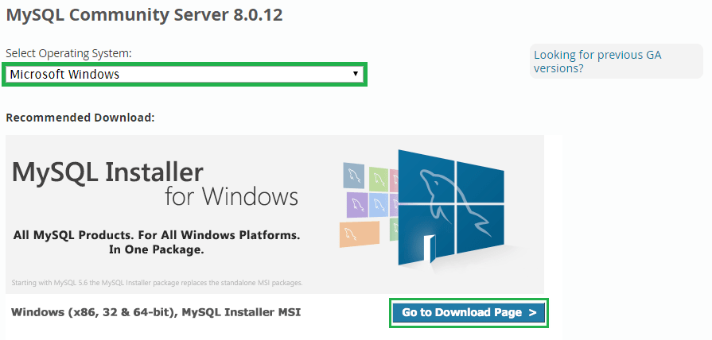
By clicking on the above URL, you will see the below options. Select your operating system (Microsoft Windows) and click on Go to Download Page. It will redirect you the actual download page for windows Mysql server.

Slide 8
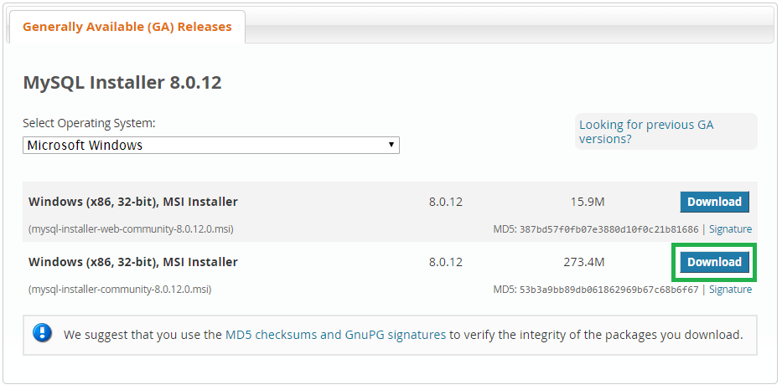
Step 2:
It will show you Generally Available (GA) Releases. Where we can see two different installers, one is a web community installer which comes as a little file and another one is MySQL installer community. Click the Download button on the second one (mysql-installer-community).

Slide 9
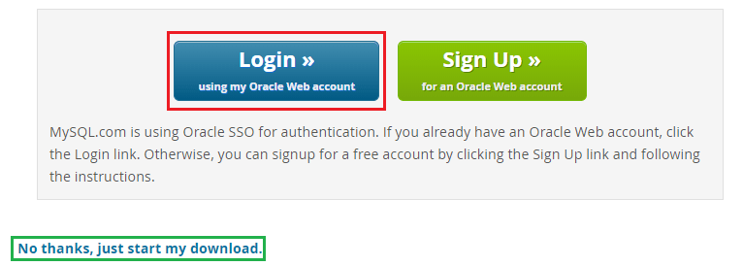
Step 3:
It will ask your MySQL credentials to download the .msi file. If you have your credentials, you can log in or else if you wish to sign up now you can click on the green coloured signup button.
If you are not interested in login or sign up for now, you can directly go and click on No thanks, just start my download option. It will download selected MySQL for you on your local machine.

Slide 10

Step 4:
Go to your downloads folder where you can see the mysql-installer-community file, right click on that file and click Install option.

Slide 11
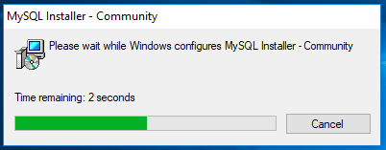
Step 5:
This window configures the installer, in the middle, it may ask you for permissions to change your computer settings or firewall confirmation, you can accept and then it will take a few seconds to configure the installer.

Slide 12
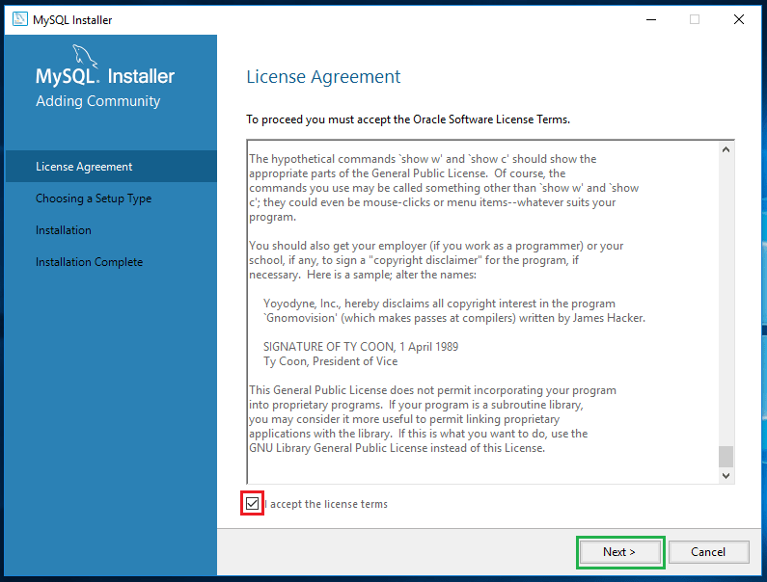
Step 6:
Read the license agreement and accept the license terms.

Slide 13
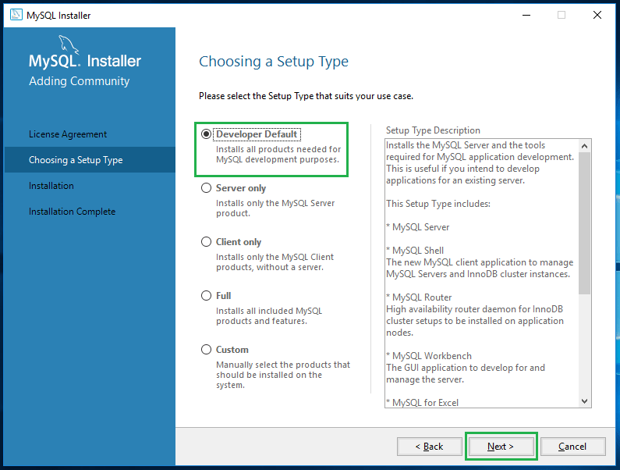
Step 7:
This window provides you to set up different types of MySQL installations. You can set up Mysql in 5 different types as provided below. Now I am selecting the Developer Default as I am a developer so that I need all the products which help my development purposes. Click on Next.

Slide 14
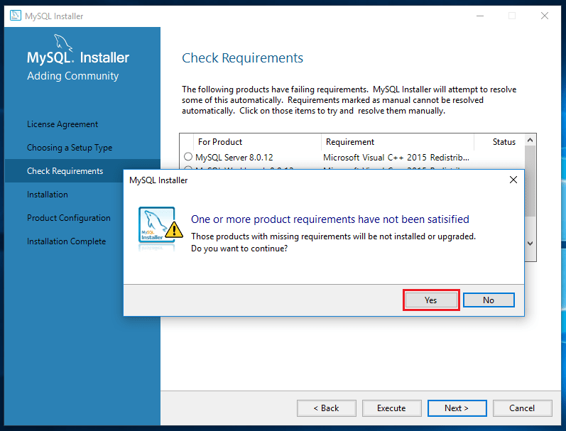
Step 8:
Based on your Windows configuration, it may prompt you like “One or more product requirements have not been satisfied”. You can just click on YES.

Slide 15
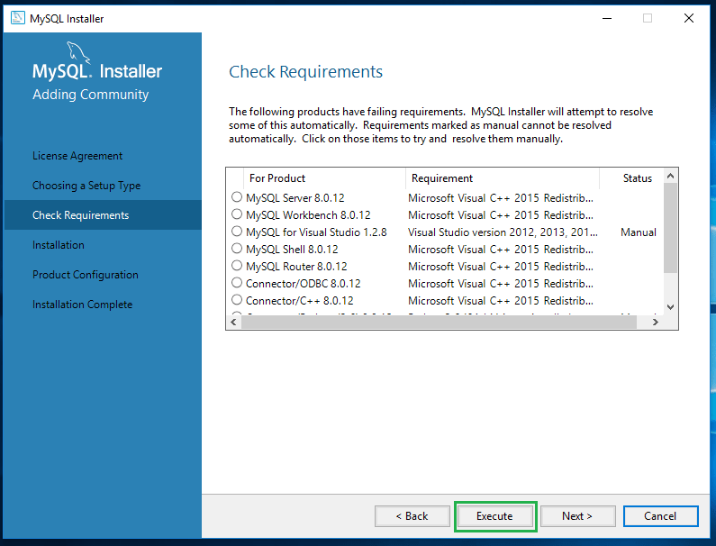
Step 9:
Click on Execute.

Slide 16
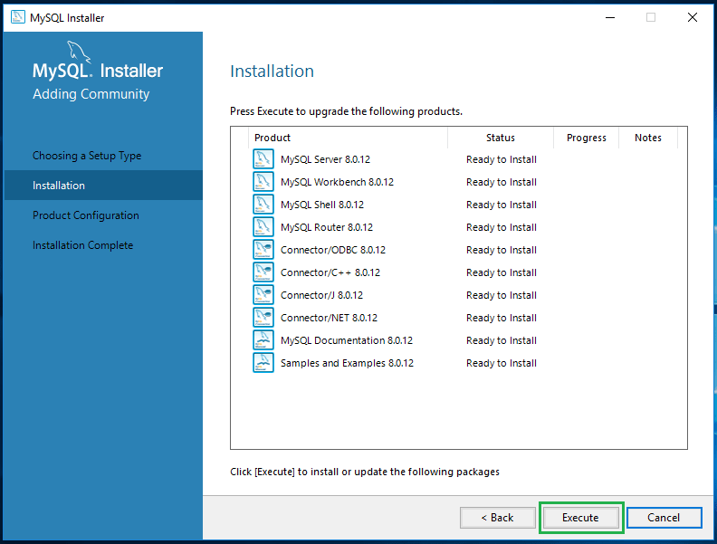
Step 10:
Upon execution of the previous step, the installer grasps all recommended products in place and asking for our approval to execute the product installation process. Click on Execute.

Slide 17
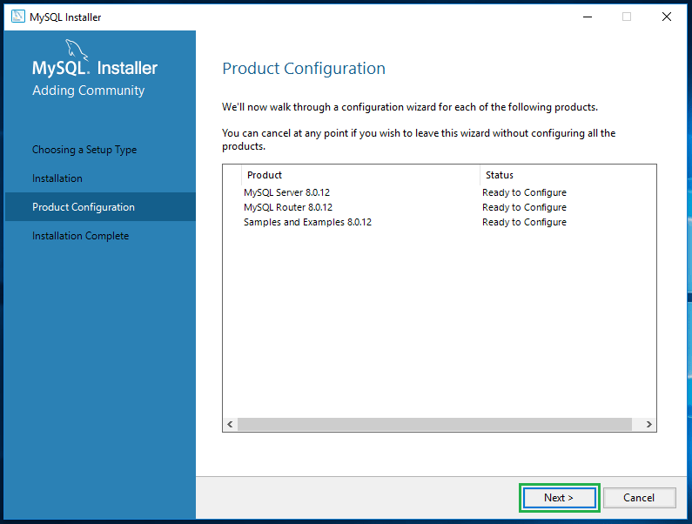
Step 11:
Upon successful execution of all required products, now the MySQL allows us to configure the server settings. Click on Next to configure the server.

Slide 18
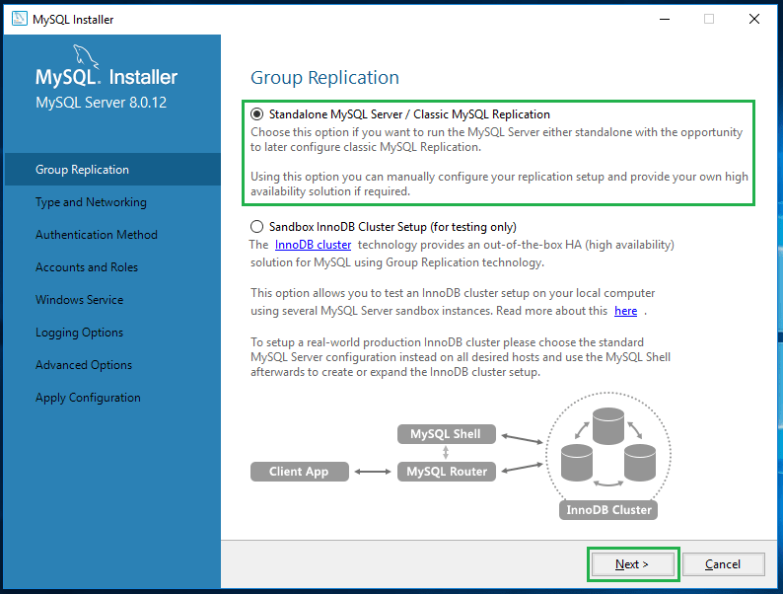
Step 12:
This step allows you to configure the server. We can set the server in two different modes. One is a standalone mode, and another one is cluster mode. I don’t want to make it as a cluster because I am installing MySQL for development purpose so that I am selecting Standalone MySQL server and click on Next.

Slide 19
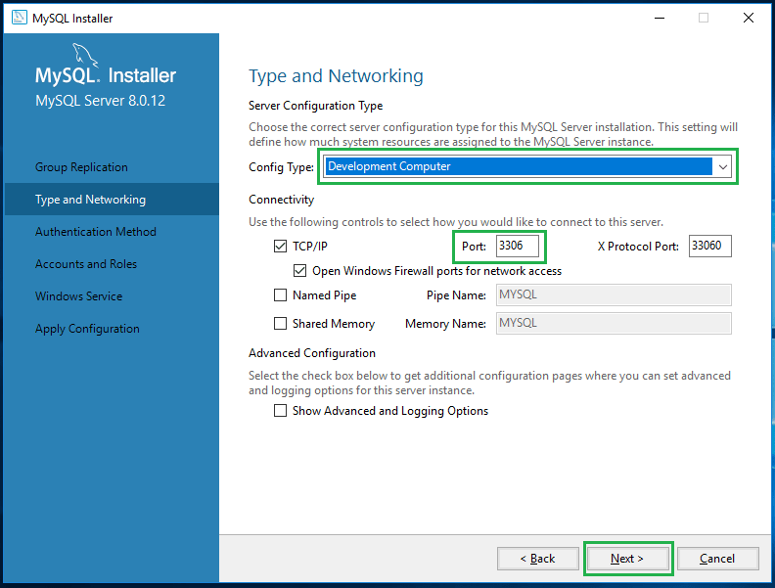
Step 14:
Choose the Development Computer option from Config Type drop-down. You can find the following controls like TCP/IP, Port and X Protocol Port. If you wish to configure your port, you can change here itself and click on Next. For now, I am leaving as its default configuration.

Slide 20
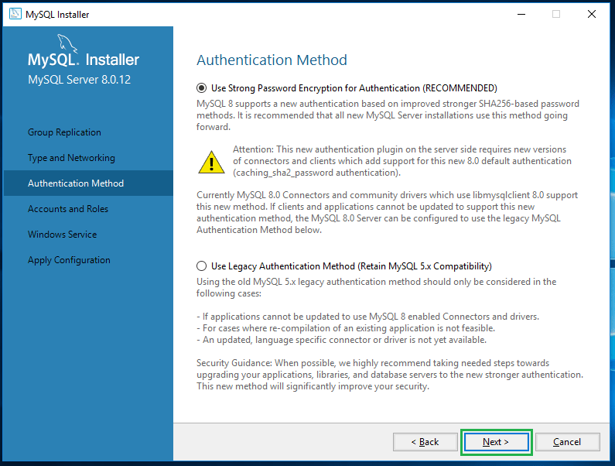
Step 15:
It is prompting you to select the authentication method, leave it as the default recommended method and click on Next.

Slide 21
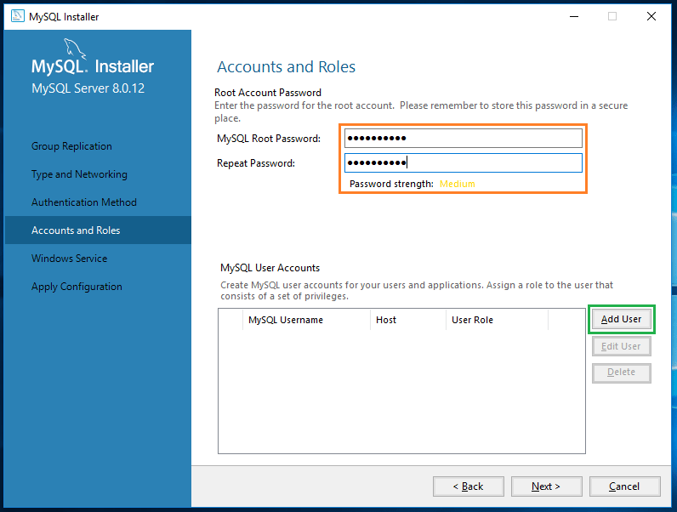
Step 16:
Here you can set your MySQL root user password. If you wish to create a new user, you can click on Add User button under MySQL user accounts section.

Slide 22
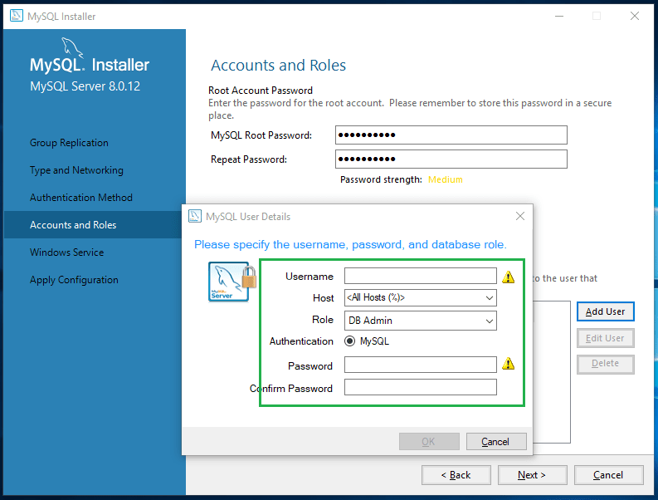
Step 17:
Upon clicking on Add User button, you will get the user details popup which allows you to create a new user account. After creating the user click on Next.

Slide 23
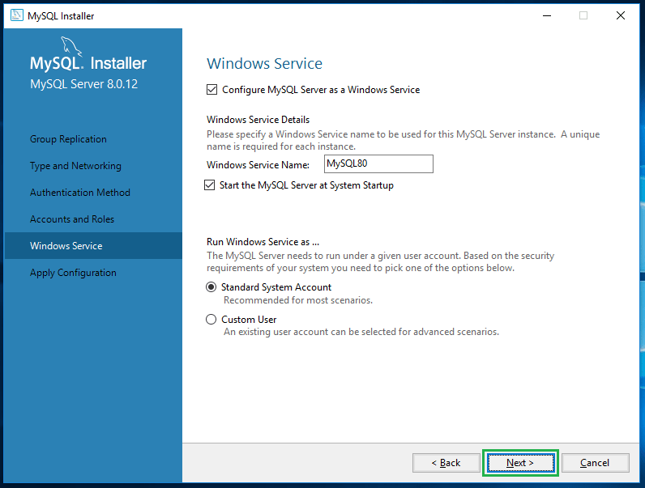
Step 18:
Leave the service details as default and click on Next.

Slide 24
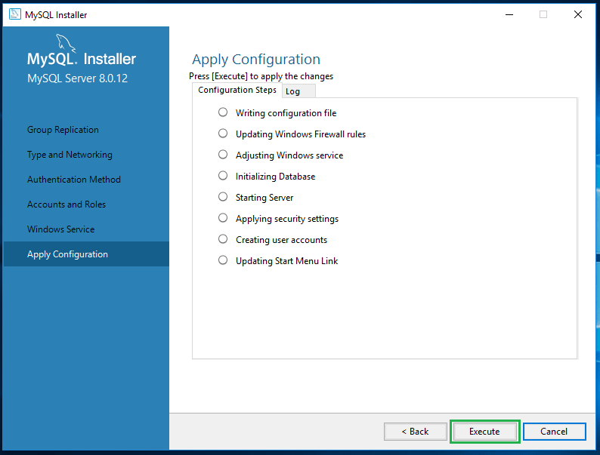
Step 19:
Press Execute to apply the configurations on the previous step

Slide 25
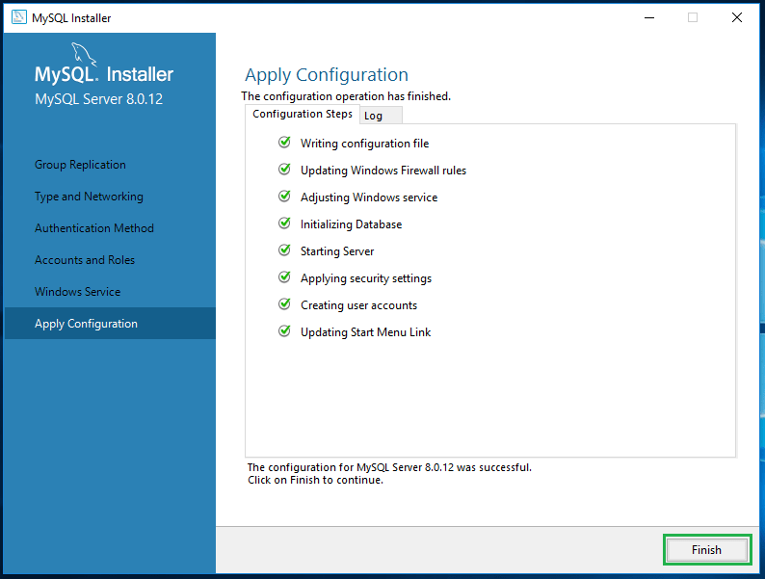
Step 20:
Upon execution, you can see the below green coloured ticks on every configuration option and finally you will get Finish button.

Slide 26
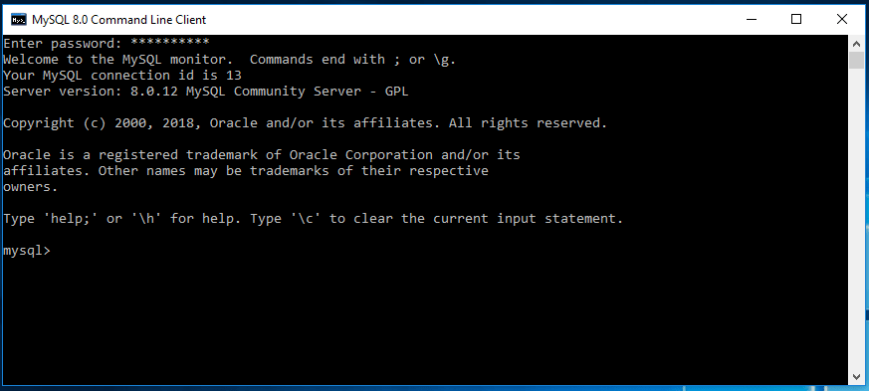
Click on Finish you got your MySQL on your Windows 10 operating system.
Testing:
Search for MySQL in your taskbar search item. There you can see all MySQL products which we installed and click on MySQL client; it will ask your MySQL password to login, after successful login you could see the MySQL prompt like below.

Slide 27
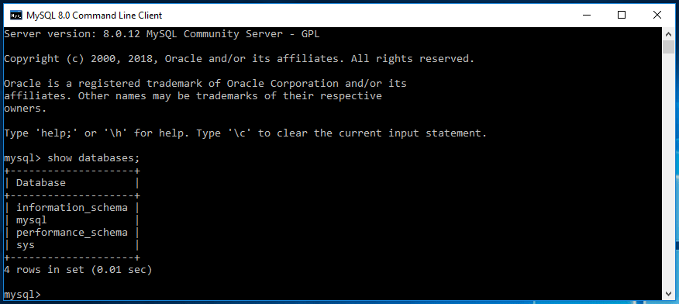
MySQL comes along with some default databases. We can see the databases by using show databases command.
We are completely done with the installation process, so now let’s create a table in it.

Slide 28
Some of The Most Important SQL Commands
SELECT - extracts data from a database
UPDATE - updates data in a database
DELETE - deletes data from a database
INSERT INTO - inserts new data into a database
CREATE DATABASE - creates a new database
ALTER DATABASE - modifies a database
CREATE TABLE - creates a new table
ALTER TABLE - modifies a table
DROP TABLE - deletes a table
CREATE INDEX - creates an index (search key)
DROP INDEX - deletes an index

Slide 29
SQL select statement
The SELECT statement is used to select data from a database.
The data returned is stored in a result table, called the result-set.
Syntax:
If you want to select all the fields available in the table, use the following syntax:
SELECT * FROM table_name;
SELECT column1, column2, ...
FROM table_name;

Slide 30
Imagine that we have a demo database which is called “customer”.
And we need some details of customers , therefore we can get that by using this command,
The following SQL statement selects the "CustomerName" and "City" columns from the "Customers" table:
SELECT CustomerName, City FROM Customers;
SELECT CustomerName, City FROM Customers;

Slide 31
The SQL SELECT DISTINCT Statement
The SELECT DISTINCT statement is used to return only distinct (different) values.
Inside a table, a column often contains many duplicate values; and sometimes you only want to list the different (distinct) values.
Syntax
SELECT DISTINCT column1, column2, ...
FROM table_name;

Slide 32
SQL WHERE Clause
The WHERE clause is used to filter records.
It is used to extract only those records that fulfill a specified condition.
WHERE Syntax
SELECT column1, column2, ...
FROM table_name
WHERE condition;
The WHERE clause is not only used in SELECT statements, it is also used in UPDATE, DELETE, etc.!

Slide 33
The following SQL statement selects all the customers from the country "Mexico", in the "Customers" table:
SELECT * FROM Customers
WHERE Country='Mexico';
Text Fields vs. Numeric Fields
SQL requires single quotes around text values (most database systems will also allow double quotes).
However, numeric fields should not be enclosed in quotes:
SELECT * FROM Customers
WHERE Country='Mexico';

Slide 34
SELECT * FROM Customers
WHERE CustomerID=1;
Operators in The WHERE Clause
The following operators can be used in the WHERE clause:
SELECT * FROM Customers
WHERE CustomerID=1;

Slide 35
Operator Description
= Equal
> Greater than
< Less than
>= Greater than or equal
<= Less than or equal
<> Not equal. Note: In some versions of SQL this operator may be written as !=
BETWEEN Between a certain range
LIKE Search for a pattern
IN To specify multiple possible values for a column

Slide 36
SQL AND, OR and NOT Operators
The WHERE clause can be combined with AND, OR, and NOT operators.
The AND and OR operators are used to filter records based on more than one condition:
The AND operator displays a record if all the conditions separated by AND are TRUE.
The OR operator displays a record if any of the conditions separated by OR is TRUE.
The NOT operator displays a record if the condition(s) is NOT TRUE.
AND Syntax
SELECT column1, column2, ...
FROM table_name
WHERE condition1 AND condition2 AND condition3 ...;
SELECT column1, column2, ...
FROM table_name
WHERE condition1 AND condition2 AND condition3 ...;

Slide 37
OR Syntax
SELECT column1, column2, ...
FROM
NOT Syntax
SELECT column1, column2, ...
FROM table_name
WHERE NOT condition;
SELECT column1, column2, ...
FROM table_name
WHERE condition1 OR condition2 OR condition3 ...;
SELECT column1, column2, ...
FROM table_name
WHERE NOT condition;

Slide 38
The following SQL statement selects all fields from "Customers" where country is "Germany" AND city is "Berlin":(and example)
The following SQL statement selects all fields from "Customers" where city is "Berlin" OR "München":(OR example)
SELECT * FROM Customers
WHERE Country='Germany' AND City='Berlin';
SELECT * FROM Customers
WHERE City='Berlin' OR City='München';

Slide 39
The following SQL statement selects all fields from "Customers" where country is NOT "Germany":(NOT example)
Combining AND, OR and NOT
You can also combine the AND, OR and NOT operators.
The following SQL statement selects all fields from "Customers" where country is "Germany" AND city must be "Berlin" OR "München" (use parentheses to form complex expressions):
SELECT * FROM Customers
WHERE NOT Country='Germany';

Slide 40
The following SQL statement selects all fields from "Customers" where country is NOT "Germany" and NOT "USA":
SELECT * FROM Customers
WHERE Country='Germany' AND (City='Berlin' OR City='München');
SELECT * FROM Customers
WHERE NOT Country='Germany' AND NOT Country='USA';

Slide 41
SQL ORDER BY Keyword
The ORDER BY keyword is used to sort the result-set in ascending or descending order.
The ORDER BY keyword sorts the records in ascending order by default. To sort the records in descending order, use the DESC keyword.
Syntax
SELECT column1, column2, ...
FROM table_name
ORDER BY column1, column2, ... ASC|DESC;

Slide 42
The following SQL statement selects all customers from the "Customers" table, sorted by the "Country" column:
The following SQL statement selects all customers from the "Customers" table, sorted DESCENDING by the "Country" column:
SELECT * FROM Customers
ORDER BY Country;
SELECT * FROM Customers
ORDER BY Country DESC;

Slide 43
Eg:1
The following SQL statement selects all customers from the "Customers" table, sorted by the "Country" and the "CustomerName" column. This means that it orders by Country, but if some rows have the same Country, it orders them by CustomerName:
SELECT * FROM Customers
ORDER BY Country, CustomerName;

Slide 44
Eg2:
The following SQL statement selects all customers from the "Customers" table, sorted ascending by the "Country" and descending by the "CustomerName" column:
SELECT * FROM Customers
ORDER BY Country ASC, CustomerName DESC;

Slide 45
SQL INSERT INTO Statement
The INSERT INTO statement is used to insert new records in a table.
INSERT INTO Syntax
It is possible to write the INSERT INTO statement in two ways:
1. Specify both the column names and the values to be inserted:
INSERT INTO table_name (column1, column2, column3, ...)
VALUES (value1, value2, value3, ...);

Slide 46
If you are adding values for all the columns of the table, you do not need to specify the column names in the SQL query. However, make sure the order of the values is in the same order as the columns in the table. Here, the INSERT INTO syntax would be as follows:
eg1:
The following SQL statement inserts a new record in the "Customers" table:
INSERT INTO table_name
VALUES (value1, value2, value3, ...);

Slide 47
Insert Data Only in Specified Columns
It is also possible to only insert data in specific columns.
The following SQL statement will insert a new record, but only insert data in the "CustomerName", "City", and "Country" columns (CustomerID will be updated automatically):
INSERT INTO Customers (CustomerName, ContactName, Address, City, PostalCode, Country)
VALUES ('Cardinal', 'Tom B. Erichsen', 'Skagen 21', 'Stavanger', '4006', 'Norway');
INSERT INTO Customers (CustomerName, City, Country)
VALUES ('Cardinal', 'Stavanger', 'Norway');

Slide 48
SQL NULL Values
A field with a NULL value is a field with no value.
If a field in a table is optional, it is possible to insert a new record or update a record without adding a value to this field. Then, the field will be saved with a NULL value.
A NULL value is different from a zero value or a field that contains spaces. A field with a NULL value is one that has been left blank during record creation!
It is not possible to test for NULL values with comparison operators, such as =, <, or <>.
We will have to use the IS NULL and IS NOT NULL operators instead.

Slide 49
IS NULL Syntax
IS NOT NULL Syntax
SELECT column_names
FROM table_name
WHERE column_name IS NULL;
SELECT column_names
FROM table_name
WHERE column_name IS NOT NULL;

Slide 50
The IS NULL operator is used to test for empty values (NULL values).
The following SQL lists all customers with a NULL value in the "Address" field:
Tip: Always use IS NULL to look for NULL values.
The IS NOT NULL operator is used to test for non-empty values (NOT NULL values).
The following SQL lists all customers with a value in the "Address" field:
SELECT CustomerName, ContactName, Address
FROM Customers
WHERE Address IS NULL;
SELECT CustomerName, ContactName, Address
FROM Customers
WHERE Address IS NOT NULL;

Slide 51
SQL UPDATE Statement
The UPDATE statement is used to modify the existing records in a table.
Syntax
Note: Be careful when updating records in a table! Notice the WHERE clause in the UPDATE statement. The WHERE clause specifies which record(s) that should be updated. If you omit the WHERE clause, all records in the table will be updated!
UPDATE table_name
SET column1 = value1, column2 = value2, ...
WHERE condition;

Slide 52
Eg:
The following SQL statement updates the first customer (CustomerID = 1) with a new contact person and a new city.
Update multiple records
It is the WHERE clause that determines how many records will be updated.
The following SQL statement will update the ContactName to "Juan" for all records where country is "Mexico":
UPDATE Customers
SET ContactName = 'Alfred Schmidt', City= 'Frankfurt'
WHERE CustomerID = 1;

Slide 53
Update Warning!
Be careful when updating records. If you omit the WHERE clause, ALL records will be updated!
Eg:
UPDATE Customers
SET ContactName='Juan'
WHERE Country='Mexico';
UPDATE Customers
SET ContactName='Juan';

Slide 54
SQL DELETE Statement
The DELETE statement is used to delete existing records in a table.
Syntax
note:Be careful when deleting records in a table! Notice the WHERE clause in the DELETE statement. The WHERE clause specifies which record(s) should be deleted. If you omit the WHERE clause, all records in the table will be deleted!
DELETE FROM table_name WHERE condition;

Slide 55
Eg:
The following SQL statement deletes the customer "Alfreds Futterkiste" from the "Customers" table:
Delete All Records
It is possible to delete all rows in a table without deleting the table. This means that the table structure, attributes, and indexes will be intact:
DELETE FROM Customers WHERE CustomerName='Alfreds Futterkiste';

Slide 56
Eg:
The following SQL statement deletes all rows in the "Customers" table, without deleting the table:
DELETE FROM table_name;
DELETE FROM Customers;

Slide 57
SQL TOP, LIMIT, FETCH FIRST or ROWNUM Clause
The SELECT TOP clause is used to specify the number of records to return.
The SELECT TOP clause is useful on large tables with thousands of records. Returning a large number of records can impact performance.
note:Not all database systems support the SELECT TOP clause. MySQL supports the LIMIT clause to select a limited number of records, while Oracle uses FETCH FIRST n ROWS ONLY and ROWNUM.
SQL Server / MS Access Syntax:
SELECT TOP number|percent column_name(s)
FROM table_name
WHERE condition;

Slide 58
MySQL Syntax:
Oracle 12 Syntax:
SELECT column_name(s)
FROM table_name
WHERE condition
LIMIT number;
SELECT column_name(s)
FROM table_name
ORDER BY column_name(s)
FETCH FIRST number ROWS ONLY;

Slide 59
Eg:
The following SQL statement selects the first three records from the "Customers" table (for SQL Server/MS Access):
The following SQL statement shows the equivalent example for MySQL:
SELECT TOP 3 * FROM Customers;
SELECT * FROM Customers
LIMIT 3;

Slide 60
The following SQL statement selects the first 50% of the records from the "Customers" table (for SQL Server/MS Access):
ADD a WHERE CLAUSE
The following SQL statement shows the equivalent example for MySQL:
SELECT TOP 50 PERCENT * FROM Customers;
SELECT * FROM Customers
WHERE Country='Germany'
LIMIT 3;

Slide 61
SQL MIN() and MAX() Functions
The MIN() function returns the smallest value of the selected column.
The MAX() function returns the largest value of the selected column.
MIN() Syntax
SELECT MIN(column_name)
FROM table_name
WHERE condition;

Slide 62
MAX() Syntax
The following SQL statement finds the price of the cheapest product:(MIN() example)
SELECT MAX(column_name)
FROM table_name
WHERE condition;
SELECT MIN(Price) AS SmallestPrice
FROM Products;

Slide 63
The following SQL statement finds the price of the most expensive product:(MAX() example)
SQL COUNT(), AVG() and SUM() Functions
The COUNT() function returns the number of rows that matches a specified criterion.
COUNT() Syntax
SELECT MAX(Price) AS LargestPrice
FROM Products;
SELECT COUNT(column_name)
FROM table_name
WHERE condition;

Slide 64
The AVG() function returns the average value of a numeric column.
AVG() Syntax
The SUM() function returns the total sum of a numeric column.
SUM() Syntax
SELECT AVG(column_name)
FROM table_name
WHERE condition;
SELECT SUM(column_name)
FROM table_name
WHERE condition;

Slide 65
The following SQL statement finds the number of products:(count() example)
Note: NULL values are not counted.
The following SQL statement finds the average price of all products:(avg() example)
The following SQL statement finds the sum of the "Quantity" fields in the "OrderDetails" table:(sum() example)
SELECT COUNT(ProductID)
FROM Products;
SELECT AVG(Price)
FROM Products;
SELECT SUM(Quantity)
FROM OrderDetails;

Slide 66
SQL LIKE Operator
The LIKE operator is used in a WHERE clause to search for a specified pattern in a column.
There are two wildcards often used in conjunction with the LIKE operator:
The percent sign (%) represents zero, one, or multiple characters
The underscore sign (_) represents one, single character
Note: MS Access uses an asterisk (*) instead of the percent sign (%), and a question mark (?) instead of the underscore (_).
The percent sign and the underscore can also be used in combinations!

Slide 67
LIKE Syntax
Tip: You can also combine any number of conditions using AND or OR operators.
Here are some examples showing different LIKE operators with '%' and '_' wildcards:
SELECT column1, column2, ...
FROM table_name
WHERE columnN LIKE pattern;

Slide 68
LIKE Operator | Description
WHERE CustomerName LIKE '%a' | Finds any values that end with "a"
WHERE CustomerName LIKE '%or%' | Finds any values that have "or" in any position
WHERE CustomerName LIKE '_r%' | Finds any values that have "r" in the second position

Slide 69
WHERE CustomerName LIKE 'a_%' Finds any values that start with "a" and are at
least 2 characters in length
WHERE CustomerName LIKE 'a__%' Finds any values that start with "a" and are at
least 3 characters in length
WHERE ContactName LIKE 'a%o' Finds any values that start with "a" and ends with "o"

Slide 70
The following SQL statement selects all customers with a CustomerName starting with "a":(sql like eg:)
The following SQL statement selects all customers with a CustomerName ending with "a":
The following SQL statement selects all customers with a CustomerName that have "or" in any position:
SELECT * FROM Customers
WHERE CustomerName LIKE 'a%';
SELECT * FROM Customers
WHERE CustomerName LIKE '%a';
SELECT * FROM Customers
WHERE CustomerName LIKE '%or%';

Slide 71
The following SQL statement selects all customers with a CustomerName that have "r" in the second position:
The following SQL statement selects all customers with a CustomerName that starts with "a" and are at least 3 characters in length:
SELECT * FROM Customers
WHERE CustomerName LIKE '_r%';
SELECT * FROM Customers
WHERE CustomerName LIKE 'a__%';

Slide 72
The following SQL statement selects all customers with a ContactName that starts with "a" and ends with "o":
The following SQL statement selects all customers with a CustomerName that does NOT start with "a":
SELECT * FROM Customers
WHERE ContactName LIKE 'a%o';
SELECT * FROM Customers
WHERE CustomerName NOT LIKE 'a%';

Slide 73
SQL Wildcards
A wildcard character is used to substitute one or more characters in a string.
Wildcard characters are used with the LIKE operator. The LIKE operator is used in a WHERE clause to search for a specified pattern in a column.
LIKE Operator Description
WHERE CustomerName LIKE 'a%' Finds any values that starts with "a"
WHERE CustomerName LIKE '%a' Finds any values that ends with "a"
WHERE CustomerName LIKE '%or%' Finds any values that have "or" in any position

Slide 74
WHERE CustomerName LIKE '_r%' Finds any values that have "r" in the second position
WHERE CustomerName LIKE 'a__%' Finds any values that starts with "a" and are at least 3
characters in length
WHERE ContactName LIKE 'a%o' Finds any values that starts with "a" and ends with "o"
The following SQL statement selects all customers with a City starting with "ber":
SELECT * FROM Customers
WHERE City LIKE 'ber%';

Slide 75
The following SQL statement selects all customers with a City containing the pattern "es":
The following SQL statement selects all customers with a City starting with any character, followed by "ondon":(Using the _ Wildcard)
The following SQL statement selects all customers with a City starting with "L", followed by any character, followed by "n", followed by any character, followed by "on":
SELECT * FROM Customers
WHERE City LIKE '%es%';
SELECT * FROM Customers
WHERE City LIKE '_ondon';

Slide 76
The following SQL statement selects all customers with a City starting with "b", "s", or "p":(Using the [charlist] Wildcard)
The following SQL statement selects all customers with a City starting with "a", "b", or "c":
SELECT * FROM Customers
WHERE City LIKE 'L_n_on';
SELECT * FROM Customers
WHERE City LIKE '[bsp]%';
SELECT * FROM Customers
WHERE City LIKE '[a-c]%';

Slide 77
The two following SQL statements select all customers with a City NOT starting with "b", "s", or "p":(Using the [!charlist] Wildcard)
SELECT * FROM Customers
WHERE City LIKE '[!bsp]%';

Slide 78
SQL CREATE DATABASE Statement
The CREATE DATABASE statement is used to create a new SQL database.
Syntax
The following SQL statement creates a database called "testDB":
CREATE DATABASE databasename;
CREATE DATABASE testDB;

Slide 79
Make sure you have admin privilege before creating any database. Once a database is created, you can check it in the list of databases with the following SQL command: SHOW DATABASES;
SQL DROP DATABASE Statement
The DROP DATABASE statement is used to drop an existing SQL database.
Syntax
Be careful before dropping a database. Deleting a database will result in loss of complete information stored in the database!
The following SQL statement drops the existing database "testDB":
DROP DATABASE databasename;
DROP DATABASE testDB;

Slide 80
SQL BACKUP DATABASE Statement
The BACKUP DATABASE statement is used in SQL Server to create a full back up of an existing SQL database.
SQL BACKUP WITH DIFFERENTIAL Statement
A differential back up only backs up the parts of the database that have changed since the last full database backup.
SYNTAX
BACKUP DATABASE databasename
TO DISK = 'filepath';
BACKUP DATABASE databasename
TO DISK = 'filepath'
WITH DIFFERENTIAL;

Slide 81
The following SQL statement creates a full back up of the existing database "testDB" to the D disk:
Always back up the database to a different drive than the actual database. Then, if you get a disk crash, you will not lose your backup file along with the database.
The following SQL statement creates a differential back up of the database "testDB":(BACKUP WITH DIFFERENTIAL Example)
BACKUP DATABASE testDB
TO DISK = 'D:\backups\testDB.bak';
BACKUP DATABASE testDB
TO DISK = 'D:\backups\testDB.bak'
WITH DIFFERENTIAL;

Slide 82
SQL CREATE TABLE Statement
The CREATE TABLE statement is used to create a new table in a database.
The column parameters specify the names of the columns of the table.
The datatype parameter specifies the type of data the column can hold (e.g. varchar, integer, date, etc.).
The following example creates a table called "Persons" that contains five columns: PersonID, LastName, FirstName, Address, and City:
CREATE TABLE table_name (
column1 datatype,
column2 datatype,
column3 datatype,
....
);

Slide 83
The PersonID column is of type int and will hold an integer.
The LastName, FirstName, Address, and City columns are of type varchar and will hold characters, and the maximum length for these fields is 255 characters.
The empty "Persons" table will now look like this:
CREATE TABLE Persons (
PersonID int,
LastName varchar(255),
FirstName varchar(255),
Address varchar(255),
City varchar(255)
);

Slide 84
Create Table Using Another Table
A copy of an existing table can also be created using CREATE TABLE.
The new table gets the same column definitions. All columns or specific columns can be selected.
If you create a new table using an existing table, the new table will be filled with the existing values from the old table.
SYNTAX
CREATE TABLE new_table_name AS
SELECT column1, column2,...
FROM existing_table_name
WHERE ....;

Slide 85
The following SQL creates a new table called "TestTables" (which is a copy of the "Customers" table):
SQL DROP TABLE Statement
The DROP TABLE statement is used to drop an existing table in a database.
SYNTAX
CREATE TABLE TestTable AS
SELECT customername, contactname
FROM customers;
DROP TABLE table_name;

Slide 86
The following SQL statement drops the existing table "Shippers":
SQL TRUNCATE TABLE
The TRUNCATE TABLE statement is used to delete the data inside a table, but not the table itself.
SYNTAX
DROP TABLE Shippers;
TRUNCATE TABLE table_name;

Slide 87
SQL ALTER TABLE Statement
The ALTER TABLE statement is used to add, delete, or modify columns in an existing table.
The ALTER TABLE statement is also used to add and drop various constraints on an existing table.
To add a column in a table, use the following syntax:
The following SQL adds an "Email" column to the "Customers" table:
ALTER TABLE Customers
ADD Email varchar(255);

Slide 88
ALTER TABLE - DROP COLUMN
To delete a column in a table, use the following syntax (notice that some database systems don't allow deleting a column):
The following SQL deletes the "Email" column from the "Customers" table:
ALTER TABLE table_name
DROP COLUMN column_name;
ALTER TABLE Customers
DROP COLUMN Email;

Slide 89
ALTER TABLE - ALTER/MODIFY COLUMN
To change the data type of a column in a table, use the following syntax:
ALTER TABLE table_name
MODIFY COLUMN column_name datatype;

Slide 90
SQL Constraints
SQL constraints are used to specify rules for data in a table.
SQL Create Constraints
Constraints can be specified when the table is created with the CREATE TABLE statement, or after the table is created with the ALTER TABLE statement.
SYNTAX
CREATE TABLE table_name (
column1 datatype constraint,
column2 datatype constraint,
column3 datatype constraint,
....
);

Slide 91
SQL Constraints
SQL constraints are used to specify rules for the data in a table.
Constraints are used to limit the type of data that can go into a table. This ensures the accuracy and reliability of the data in the table. If there is any violation between the constraint and the data action, the action is aborted.
Constraints can be column level or table level. Column level constraints apply to a column, and table level constraints apply to the whole table.
The following constraints are commonly used in SQL:
NOT NULL - Ensures that a column cannot have a NULL value
UNIQUE - Ensures that all values in a column are different
PRIMARY KEY - A combination of a NOT NULL and UNIQUE. Uniquely identifies each row in a table
FOREIGN KEY - Prevents actions that would destroy links between tables
CHECK - Ensures that the values in a column satisfies a specific condition
DEFAULT - Sets a default value for a column if no value is specified
CREATE INDEX - Used to create and retrieve data from the database very quickly

Slide 92
SQL NOT NULL Constraint
By default, a column can hold NULL values.
The NOT NULL constraint enforces a column to NOT accept NULL values.
This enforces a field to always contain a value, which means that you cannot insert a new record, or update a record without adding a value to this field.
SQL NOT NULL on CREATE TABLE
The following SQL ensures that the "ID", "LastName", and "FirstName" columns will NOT accept NULL values when the "Persons" table is created:

Slide 93
SQL NOT NULL on ALTER TABLE
To create a NOT NULL constraint on the "Age" column when the "Persons" table is already created, use the following SQL:
CREATE TABLE Persons (
ID int NOT NULL,
LastName varchar(255) NOT NULL,
FirstName varchar(255) NOT NULL,
Age int
);
ALTER TABLE Persons
MODIFY Age int NOT NULL;

Slide 94
SQL UNIQUE Constraint
The UNIQUE constraint ensures that all values in a column are different.
Both the UNIQUE and PRIMARY KEY constraints provide a guarantee for uniqueness for a column or set of columns.
A PRIMARY KEY constraint automatically has a UNIQUE constraint.
However, you can have many UNIQUE constraints per table, but only one PRIMARY KEY constraint per table.
SQL UNIQUE Constraint on CREATE TABLE
The following SQL creates a UNIQUE constraint on the "ID" column when the "Persons" table is created:

Slide 95
CREATE TABLE Persons (
ID int NOT NULL,
LastName varchar(255) NOT NULL,
FirstName varchar(255),
Age int,
UNIQUE (ID)
);
To name a UNIQUE constraint, and to define a UNIQUE constraint on multiple columns, use the following SQL syntax:
CREATE TABLE Persons (
ID int NOT NULL,
LastName varchar(255) NOT NULL,
FirstName varchar(255),
Age int,
CONSTRAINT UC_Person UNIQUE (ID,LastName)
);

Slide 96
SQL UNIQUE Constraint on ALTER TABLE
To create a UNIQUE constraint on the "ID" column when the table is already created, use the following SQL:
To name a UNIQUE constraint, and to define a UNIQUE constraint on multiple columns, use the following SQL syntax:
ALTER TABLE Persons
ADD UNIQUE (ID);
ALTER TABLE Persons
ADD CONSTRAINT UC_Person UNIQUE (ID,LastName);

Slide 97
DROP a UNIQUE Constraint
To drop a UNIQUE constraint, use the following SQL:
ALTER TABLE Persons
DROP INDEX UC_Person;

Slide 98
SQL PRIMARY KEY Constraint
The PRIMARY KEY constraint uniquely identifies each record in a table.
Primary keys must contain UNIQUE values, and cannot contain NULL values.
A table can have only ONE primary key; and in the table, this primary key can consist of single or multiple columns (fields).
The following SQL creates a PRIMARY KEY on the "ID" column when the "Persons" table is created:
CREATE TABLE Persons (
ID int NOT NULL,
LastName varchar(255) NOT NULL,
FirstName varchar(255),
Age int,
PRIMARY KEY (ID)
);

Slide 99
To allow naming of a PRIMARY KEY constraint, and for defining a PRIMARY KEY constraint on multiple columns, use the following SQL syntax:
In the example above there is only ONE PRIMARY KEY (PK_Person). However, the VALUE of the primary key is made up of TWO COLUMNS (ID + LastName).
SQL PRIMARY KEY on ALTER TABLE
To create a PRIMARY KEY constraint on the "ID" column when the table is already created, use the following SQL:
CREATE TABLE Persons (
ID int NOT NULL,
LastName varchar(255) NOT NULL,
FirstName varchar(255),
Age int,
CONSTRAINT PK_Person PRIMARY KEY (ID,LastName)
);

Slide 100
To allow naming of a PRIMARY KEY constraint, and for defining a PRIMARY KEY constraint on multiple columns, use the following SQL syntax:
If you use ALTER TABLE to add a primary key, the primary key column(s) must have been declared to not contain NULL values (when the table was first created).
ALTER TABLE Persons
ADD PRIMARY KEY (ID);
ALTER TABLE Persons
ADD CONSTRAINT PK_Person PRIMARY KEY (ID,LastName);

Slide 101
SQL FOREIGN KEY Constraint
The FOREIGN KEY constraint is used to prevent actions that would destroy links between tables.
A FOREIGN KEY is a field (or collection of fields) in one table, that refers to the PRIMARY KEY in another table.
The table with the foreign key is called the child table, and the table with the primary key is called the referenced or parent table.
The FOREIGN KEY constraint prevents invalid data from being inserted into the foreign key column, because it has to be one of the values contained in the parent table.
ALTER TABLE Persons
DROP PRIMARY KEY;

Slide 102
The following SQL creates a FOREIGN KEY on the "PersonID" column when the "Orders" table is created:
To allow naming of a FOREIGN KEY constraint, and for defining a FOREIGN KEY constraint on multiple columns, use the following SQL syntax:
CREATE TABLE Orders (
OrderID int NOT NULL,
OrderNumber int NOT NULL,
PersonID int,
PRIMARY KEY (OrderID),
FOREIGN KEY (PersonID) REFERENCES Persons(PersonID)
);
CREATE TABLE Orders (
OrderID int NOT NULL,
OrderNumber int NOT NULL,
PersonID int,
PRIMARY KEY (OrderID),
CONSTRAINT FK_PersonOrder FOREIGN KEY (PersonID)
REFERENCES Persons(PersonID)
);

Slide 103
SQL FOREIGN KEY on ALTER TABLE
To create a FOREIGN KEY constraint on the "PersonID" column when the "Orders" table is already created, use the following SQL:
To allow naming of a FOREIGN KEY constraint, and for defining a FOREIGN KEY constraint on multiple columns, use the following SQL syntax:
ALTER TABLE Orders
ADD FOREIGN KEY (PersonID) REFERENCES Persons(PersonID);
ALTER TABLE Orders
ADD CONSTRAINT FK_PersonOrder
FOREIGN KEY (PersonID) REFERENCES Persons(PersonID);

Slide 104
DROP a FOREIGN KEY Constraint
To drop a FOREIGN KEY constraint, use the following SQL:
SQL CHECK Constraint
The CHECK constraint is used to limit the value range that can be placed in a column.
If you define a CHECK constraint on a column it will allow only certain values for this column.
If you define a CHECK constraint on a table it can limit the values in certain columns based on values in other columns in the row.
ALTER TABLE Orders
DROP FOREIGN KEY FK_PersonOrder;

Slide 105
The following SQL creates a CHECK constraint on the "Age" column when the "Persons" table is created. The CHECK constraint ensures that the age of a person must be 18, or older:
To allow naming of a CHECK constraint, and for defining a CHECK constraint on multiple columns, use the following SQL syntax:
CREATE TABLE Persons (
ID int NOT NULL,
LastName varchar(255) NOT NULL,
FirstName varchar(255),
Age int,
CHECK (Age>=18)
);
CREATE TABLE Persons (
ID int NOT NULL,
LastName varchar(255) NOT NULL,
FirstName varchar(255),
Age int,
City varchar(255),
CONSTRAINT CHK_Person CHECK (Age>=18 AND City='Sandnes')
);

Slide 106
To create a CHECK constraint on the "Age" column when the table is already created, use the following SQL:
To allow naming of a CHECK constraint, and for defining a CHECK constraint on multiple columns, use the following SQL syntax:
To drop a CHECK constraint, use the following SQL:
ALTER TABLE Persons
ADD CHECK (Age>=18);
ALTER TABLE Persons
ADD CONSTRAINT CHK_PersonAge CHECK (Age>=18 AND City='Sandnes');
ALTER TABLE Persons
DROP CHECK CHK_PersonAge;

Slide 107
SQL DEFAULT Constraint
The DEFAULT constraint is used to set a default value for a column.
The default value will be added to all new records, if no other value is specified.
The following SQL sets a DEFAULT value for the "City" column when the "Persons" table is created:
The DEFAULT constraint can also be used to insert system values, by using functions like GETDATE():
CREATE TABLE Persons (
ID int NOT NULL,
LastName varchar(255) NOT NULL,
FirstName varchar(255),
Age int,
City varchar(255) DEFAULT 'Sandnes'
);

Slide 108
To create a DEFAULT constraint on the "City" column when the table is already created, use the following SQL:
To drop a DEFAULT constraint, use the following SQL:
CREATE TABLE Orders (
ID int NOT NULL,
OrderNumber int NOT NULL,
OrderDate date DEFAULT GETDATE()
);
ALTER TABLE Persons
ALTER City SET DEFAULT 'Sandnes';
ALTER TABLE Persons
ALTER City DROP DEFAULT;

Slide 109
SQL CREATE INDEX Statement
The CREATE INDEX statement is used to create indexes in tables.
Indexes are used to retrieve data from the database more quickly than otherwise. The users cannot see the indexes, they are just used to speed up searches/queries.
Updating a table with indexes takes more time than updating a table without (because the indexes also need an update). So, only create indexes on columns that will be frequently searched against.
Creates an index on a table. Duplicate values are allowed:
CREATE INDEX index_name
ON table_name (column1, column2, ...);

Slide 110
Creates a unique index on a table. Duplicate values are not allowed:
The syntax for creating indexes varies among different databases. Therefore: Check the syntax for creating indexes in your database.
eg:
The SQL statement below creates an index named "idx_lastname" on the "LastName" column in the "Persons" table:
CREATE UNIQUE INDEX index_name
ON table_name (column1, column2, ...);
CREATE INDEX idx_lastname
ON Persons (LastName);

Slide 111
If you want to create an index on a combination of columns, you can list the column names within the parentheses, separated by commas:
DROP INDEX Statement
The DROP INDEX statement is used to delete an index in a table.
CREATE INDEX idx_pname
ON Persons (LastName, FirstName);
ALTER TABLE table_name
DROP INDEX index_name;

Slide 112
SQL AUTO INCREMENT Field
Auto-increment allows a unique number to be generated automatically when a new record is inserted into a table.
Often this is the primary key field that we would like to be created automatically every time a new record is inserted.
Syntax
The following SQL statement defines the "Personid" column to be an auto-increment primary key field in the "Persons" table:
CREATE TABLE Persons (
Personid int NOT NULL AUTO_INCREMENT,
LastName varchar(255) NOT NULL,
FirstName varchar(255),
Age int,
PRIMARY KEY (Personid)
);

Slide 113
MySQL uses the AUTO_INCREMENT keyword to perform an auto-increment feature.
By default, the starting value for AUTO_INCREMENT is 1, and it will increment by 1 for each new record.
To let the AUTO_INCREMENT sequence start with another value, use the following SQL statement:
To insert a new record into the "Persons" table, we will NOT have to specify a value for the "Personid" column (a unique value will be added automatically):
The SQL statement above would insert a new record into the "Persons" table. The "Personid" column would be assigned a unique value. The "FirstName" column would be set to "Lars" and the "LastName" column would be set to "Monsen".
ALTER TABLE Persons AUTO_INCREMENT=100;
INSERT INTO Persons (FirstName,LastName)
VALUES ('Lars','Monsen');

Slide 114
SQL Working With Dates
SQL Dates
As long as your data contains only the date portion, your queries will work as expected. However, if a time portion is involved, it gets more complicated.
MySQL comes with the following data types for storing a date or a date/time value in the database:
DATE - format YYYY-MM-DD
DATETIME - format: YYYY-MM-DD HH:MI:SS
TIMESTAMP - format: YYYY-MM-DD HH:MI:SS
YEAR - format YYYY or YY
SELECT * FROM Orders WHERE OrderDate='2008-11-11'

Slide 115
SQL Views
In SQL, a view is a virtual table based on the result-set of an SQL statement.
A view contains rows and columns, just like a real table. The fields in a view are fields from one or more real tables in the database.
You can add SQL statements and functions to a view and present the data as if the data were coming from one single table.
A view is created with the CREATE VIEW statement.
CREATE VIEW Syntax
CREATE VIEW view_name AS
SELECT column1, column2, ...
FROM table_name
WHERE condition;

Slide 116
The following SQL creates a view that shows all customers from Brazil:
We can query the view above as follows:
SELECT * FROM [Brazil Customers];
The following SQL creates a view that selects every product in the "Products" table with a price higher than the average price
CREATE VIEW [Brazil Customers] AS
SELECT CustomerName, ContactName
FROM Customers
WHERE Country = 'Brazil';
CREATE VIEW [Products Above Average Price] AS
SELECT ProductName, Price
FROM Products
WHERE Price > (SELECT AVG(Price) FROM Products);

Slide 117
We can query the view above as follows:
SQL Injection
SQL injection is a code injection technique that might destroy your database.
SQL injection is one of the most common web hacking techniques.
SQL injection is the placement of malicious code in SQL statements, via web page input.
SELECT * FROM [Products Above Average Price];

Slide 118
SQL in Web Pages
SQL injection usually occurs when you ask a user for input, like their username/userid, and instead of a name/id, the user gives you an SQL statement that you will unknowingly run on your database.
Look at the following example which creates a SELECT statement by adding a variable (txtUserId) to a select string. The variable is fetched from user input (getRequestString):
The rest of this chapter describes the potential dangers of using user input in SQL statements.
txtUserId = getRequestString("UserId");
txtSQL = "SELECT * FROM Users WHERE UserId = " + txtUserId;

Slide 119
SQL Injection Based on 1=1 is Always True
Look at the example above again. The original purpose of the code was to create an SQL statement to select a user, with a given user id.
If there is nothing to prevent a user from entering "wrong" input, the user can enter some "smart" input like this:
UserId: 105 OR 1=1
Then, the SQL statement will look like this:
The SQL above is valid and will return ALL rows from the "Users" table, since OR 1=1 is always TRUE.
Does the example above look dangerous? What if the "Users" table contains names and passwords?
The SQL statement above is much the same as this:
SELECT * FROM Users WHERE UserId = 105 OR 1=1;

Slide 120
A hacker might get access to all the user names and passwords in a database, by simply inserting 105 OR 1=1 into the input field.
SQL Injection Based on ""="" is Always True
Here is an example of a user login on a web site:
Username:John Doe
Password:myPass
uName = getRequestString("username");
uPass = getRequestString("userpassword");
sql = 'SELECT * FROM Users WHERE Name ="' + uName + '" AND Pass ="' + uPass + '"'
SELECT UserId, Name, Password FROM Users WHERE UserId = 105 or 1=1;

Slide 121
Result
A hacker might get access to user names and passwords in a database by simply inserting " OR ""=" into the user name or password text box:
User Name:" or ""="
Password:" or ""="
The code at the server will create a valid SQL statement like this:
Result
The SQL above is valid and will return all rows from the "Users" table, since OR ""="" is always TRUE.
SELECT * FROM Users WHERE Name ="John Doe" AND Pass ="myPass"
SELECT * FROM Users WHERE Name ="" or ""="" AND Pass ="" or ""=""

Slide 122
SQL Injection Based on Batched SQL Statements
Most databases support batched SQL statement.
A batch of SQL statements is a group of two or more SQL statements, separated by semicolons.
The SQL statement below will return all rows from the "Users" table, then delete the "Suppliers" table.
Eg:
Eg2:
SELECT * FROM Users; DROP TABLE Suppliers
txtUserId = getRequestString("UserId");
txtSQL = "SELECT * FROM Users WHERE UserId = " + txtUserId;

Slide 123
And the following input:
User id: 105; DROP TABLE Suppliers
The valid SQL statement would look like this:
Result
Use SQL Parameters for Protection
To protect a web site from SQL injection, you can use SQL parameters.
SQL parameters are values that are added to an SQL query at execution time, in a controlled manner.
SELECT * FROM Users WHERE UserId = 105; DROP TABLE Suppliers;

Slide 124
ASP.NET Razor Example
Note that parameters are represented in the SQL statement by a @ marker.
The SQL engine checks each parameter to ensure that it is correct for its column and are treated literally, and not as part of the SQL to be executed.
eg2:
txtUserId = getRequestString("UserId");
txtSQL = "SELECT * FROM Users WHERE UserId = @0";
db.Execute(txtSQL,txtUserId);
txtNam = getRequestString("CustomerName");
txtAdd = getRequestString("Address");
txtCit = getRequestString("City");
txtSQL = "INSERT INTO Customers (CustomerName,Address,City) Values(@0,@1,@2)";
db.Execute(txtSQL,txtNam,txtAdd,txtCit);

Slide 125
SQL Hosting
If you want your web site to be able to store and retrieve data from a database, your web server should have access to a database-system that uses the SQL language.
If your web server is hosted by an Internet Service Provider (ISP), you will have to look for SQL hosting plans.
The most common SQL hosting databases are MS SQL Server, Oracle, MySQL, and MS Access.
MySQL
MySQL is also a popular database software for web sites.
MySQL is a very powerful, robust and full featured SQL database system.
MySQL is an inexpensive alternative to the expensive Microsoft and Oracle solutions.

Slide 126
Thank you

